Slide 1
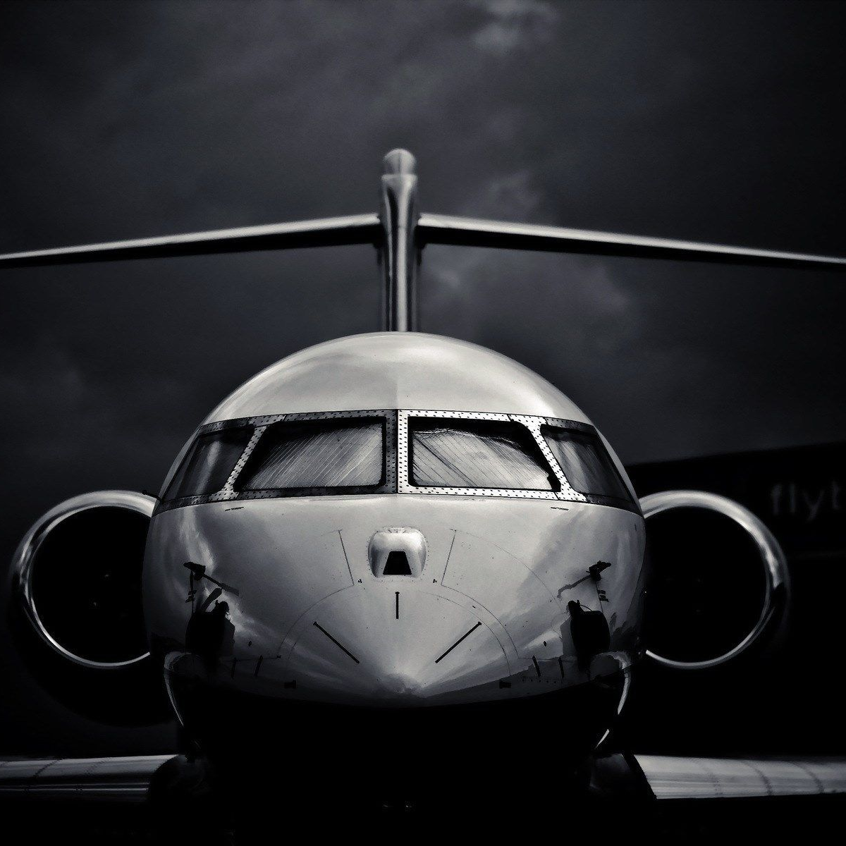
Airline Safety Analysis Executive Review: Summary
DSC 640
TANIYA ADHIKARI

Slide 2

OVERVIEW
Due to a recent unfortunate airline crashes, there has been lot of media attention to airline industry. Several negative information has been shared to public indicating that airline travel is no longer safe.
Our team has performed in-depth analysis on 25+ years of US airline industry and global safety data to find solution to the current problem.
In the next few slides, we will be reviewing airline safety and future prospect of our company and industry using 2000-2020 years statistics

Slide 3






OBJECTIVES
To present information about airline safety trends globally.
To understand how fatalities trends have changed for U.S airlines.
U.S airlines metrics compared to world and other transportation modes
To review airlines specific financial metrics for U.S industry/airlines.
Use this information to recognize future risks and position of the company.
End with recommendations on tackling current issue regarding media coverage

Slide 4
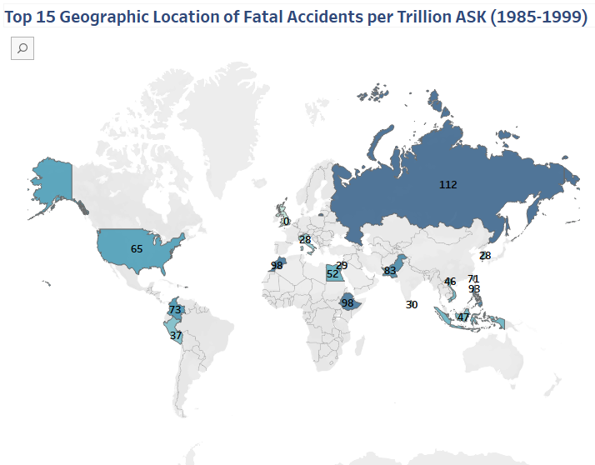
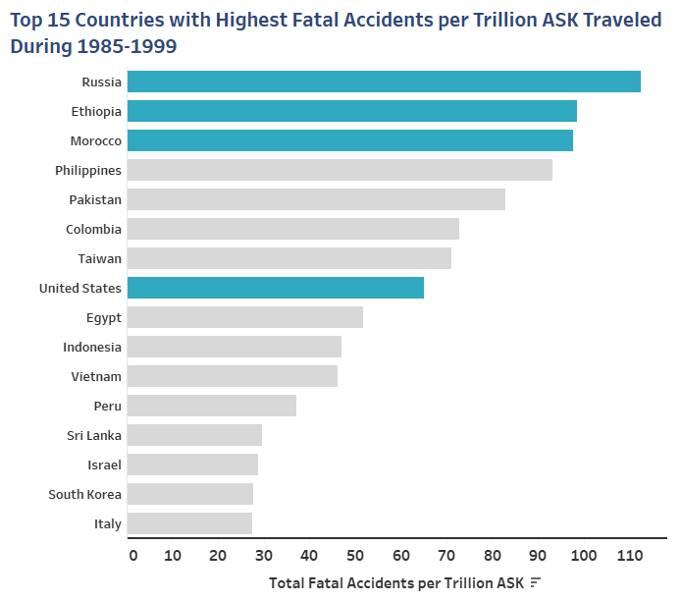

Before 2000s…U.S Airlines had high incidents per Trillion ASK
From 1985 to 1999, U.S airlines were among the few airlines with high fatal accidents around the world in terms of Available Seats per Kilometers in Trillions.
Note: Rates are calculated per by available seats per km in trillions

Slide 5
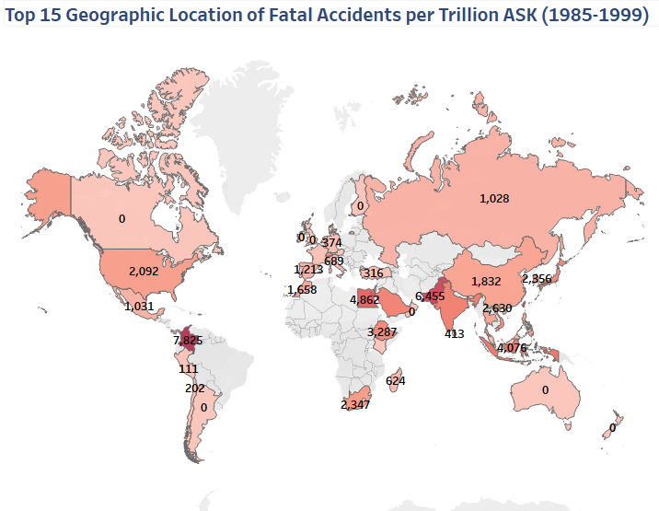
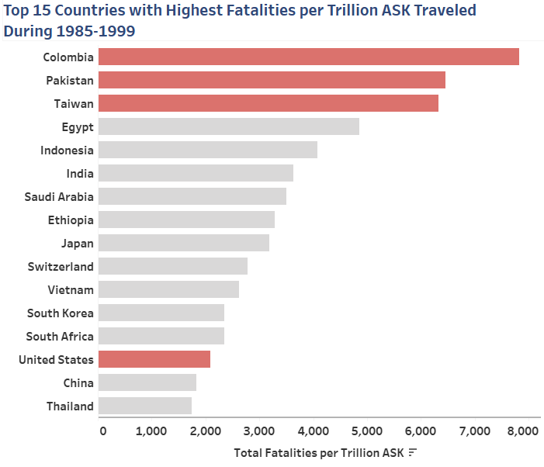

…U.S Airlines also had high fatalities per Trillion ASK
From 1985 to 1999, U.S airlines were among the few airlines with high fatalities around the world in terms of Available Seats per Kilometers in Trillions.
Note: Rates are calculated per by available seats per km in trillions

Slide 6
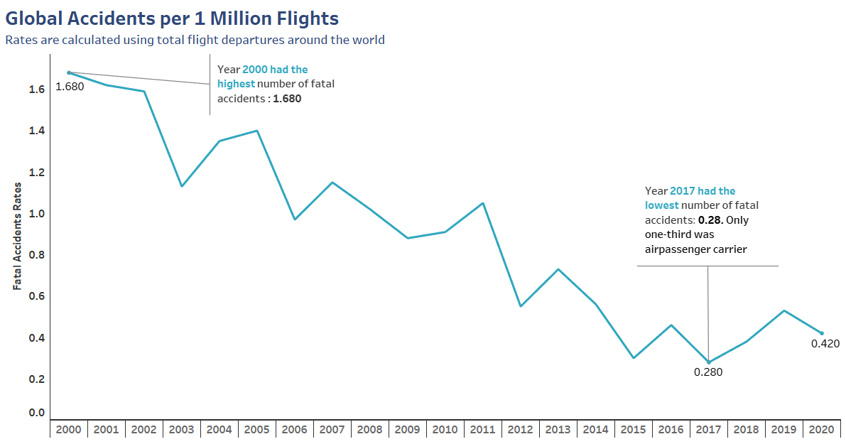
Globally world airlines Safety has increased over time
From 2000-2020 Airlines Safety has increased as accidents rates have declined over time. Current rate of accident in 2020 is 0.42 per 1 million flight which 75% lower than 1.68 per 1 million Flight in 2000.
Note: Accident Rates are calculated per 1 million flights, to scale it to visualize.

Slide 7
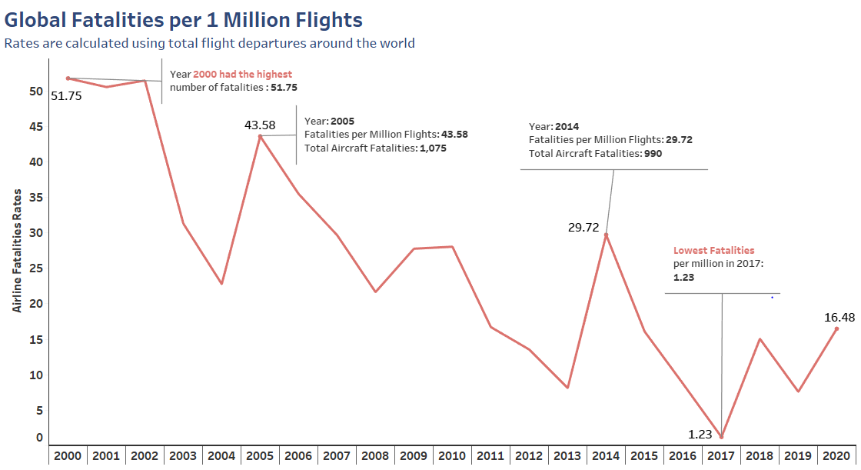
Additionally, Death rates from airline accidents have also declined.
Overall fatalities have declined since 2000-2020. However, there few exceptions as the curve is not a smooth decline.
Current rate of fatalities in 2020 is 16.48 per 1 million flight which 68.2% lower than 51.75 per 1 million Flight in 2000.
Note: Fatalities Rates are calculated per 1 million flights, to scale it to visualize.

Slide 8
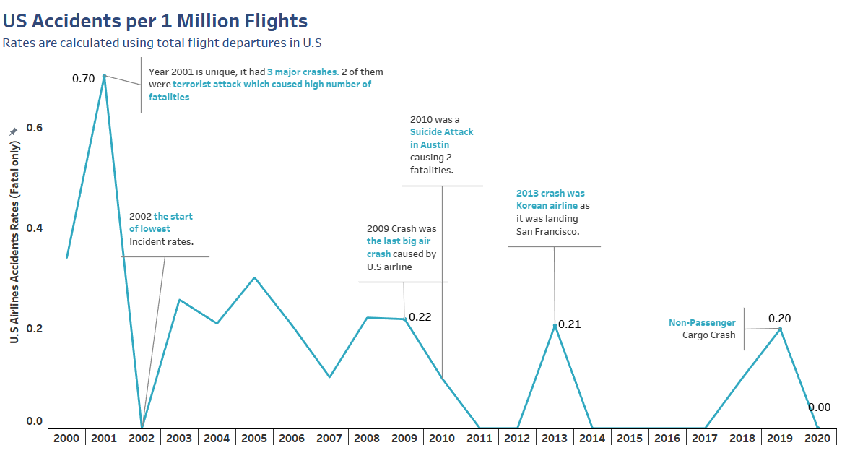
U.S safety has increased dramatically in recent years
Fatal Accidents in U.S Airlines has gotten down to zero for most part since 2000-2020.
In 2001, U.S had 3 unfortunate events that contributed to many fatalities, however, 2 of them were hijacks. The 2009 was the last commercial airline plane crash, since then strict policies were made by FAA to prevent fatal accidents. Current rate of accident in 2020 is 0.0 per 1 million flight which is 70% lower than its highest accidents per million flights in 2001.
0.34

Slide 9
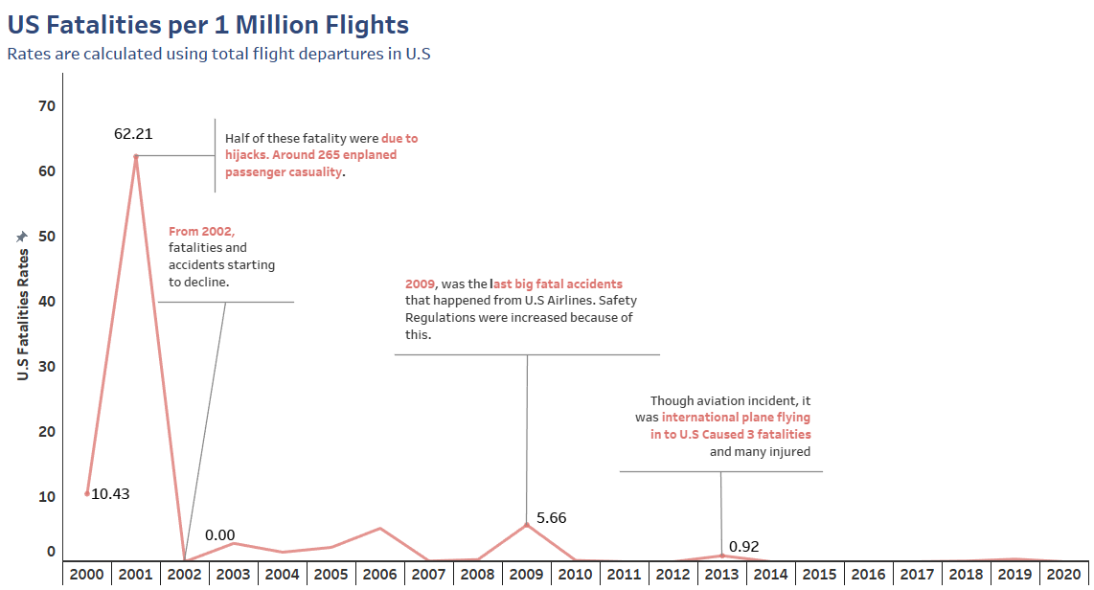
U.S Airline Fatality rates are even better
After 2001 incidents, fatalities have decreased tremendously, as accident rates were also lowered.
After 2009 plane crash, strict regulations were put in place, to increase passenger safety. Since, then fatalities have stayed around 0.0 per million flights. Airlines fatality rates have declined by 100%

Slide 10


Now, U.S Airlines are safer than international airlines
After 2000, U.S and worldwide accidents and fatalities have declined in terms of number of flight departures by 2020. We compared rates based on number of flights departures around the world and it is indicating U.S airlines are safer than international airlines.
U.S Airlines fatalities per 1 Million flights declined by 100.0% compared to 68.1% worldwide.
U.S Airlines accidents per 1 Million flights declined by 100.0% compared to 75.0% worldwide.
U.S Airlines
World Airlines
U.S Airlines
World Airlines

Slide 11
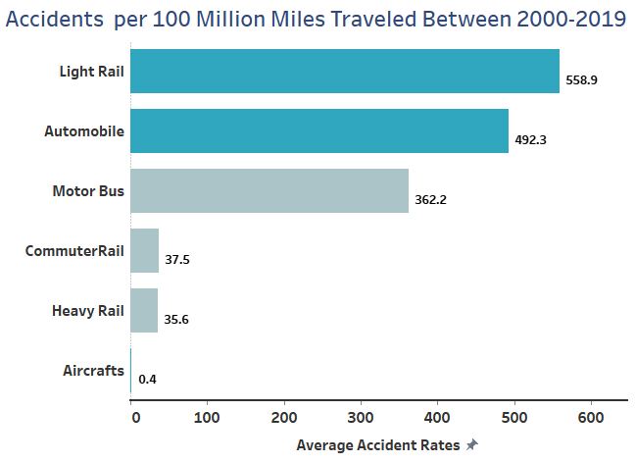
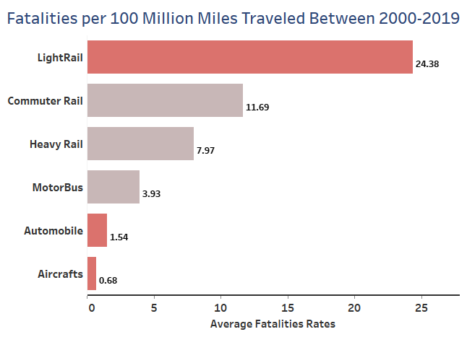
Airlines are also the safest way to travel in U.S
Between 2000-2019 Air carrier on average had lowest accidents than any other Modes of Transportation in US. Chances of getting in a plane crash is 0.4 for every 100 Million Miles Traveled, lower than automobiles which has 492.3 for every Million Miles.
Fatalities Rates for Air carrier were also lowest when compared to other Modes of Transportation in 2000-2019. Chances of Dying from plane crash is 0.68 for every 100 Million Miles Traveled, compared to automobiles had 1.54 for every 100 Million Miles Traveled.

Slide 12
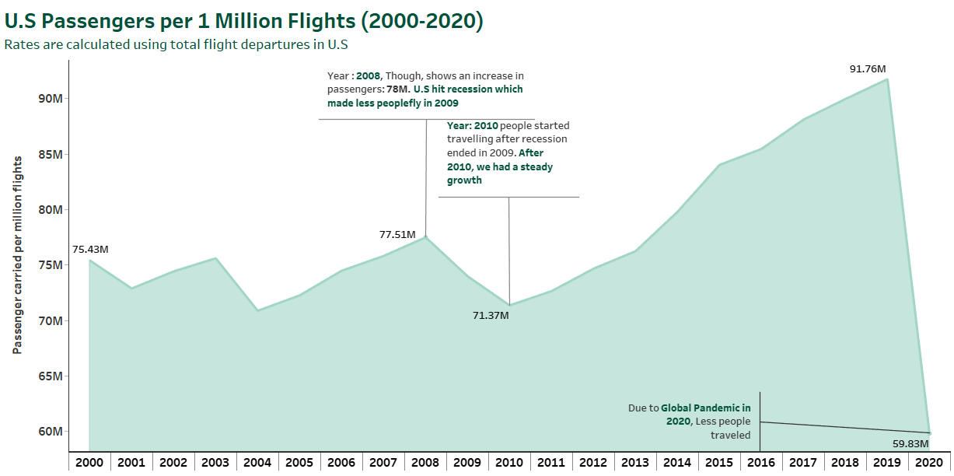
US. Airlines demand is growing steadily over time
After recession ended in 2009, there has been a sharp increase from 2010 of 20.4 Million in Passenger carried per 1 Million Flights indicating that U.S airlines demand is increasing since 2010.
In 2020, there is a drop in total passenger carried due to Global pandemic. Though not relevant to plane crash, this is a potential safety hazard, and a reason for people to avoid travel.
Note: Y-Axis is not set to 0 baseline, due to millions being too large to graph with 0 zero baseline

Slide 13
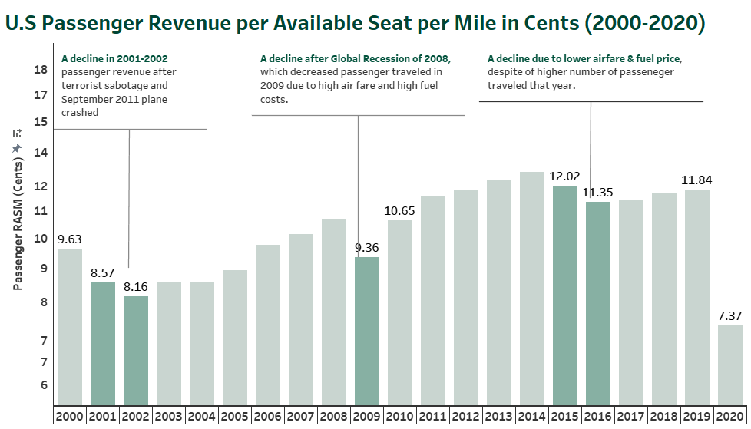
US. Airlines financial performance increased
Revenue generated by Passenger per ASM has increased indicating, that airline industry has financially performed well over time and had growth in passenger revenue per unit.
Note: Y-Axis is not set to 0 baseline, due to millions being too large to graph with 0 zero baseline

Slide 14
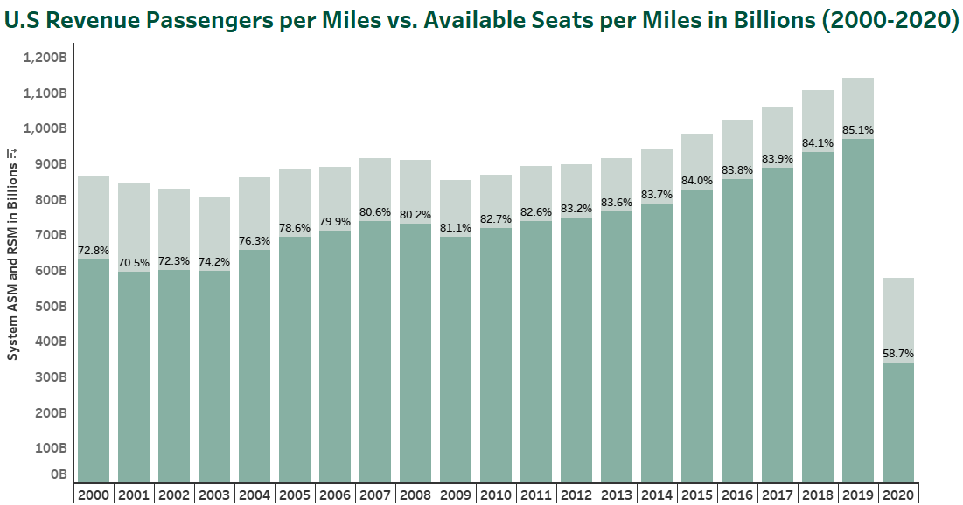

US. Airlines increasingly filling in ASM over time
After 2001 incident, Airlines Load factor has been increasing over time steadily till 2019, meaning, airline traffic volume has increased compared to ASM.
2020, has by far the worst year and had the lowest load factor of 58.7%. Additionally, ASM has been decreased as well due to global pandemic this is potential financial risk to industry.

Slide 15
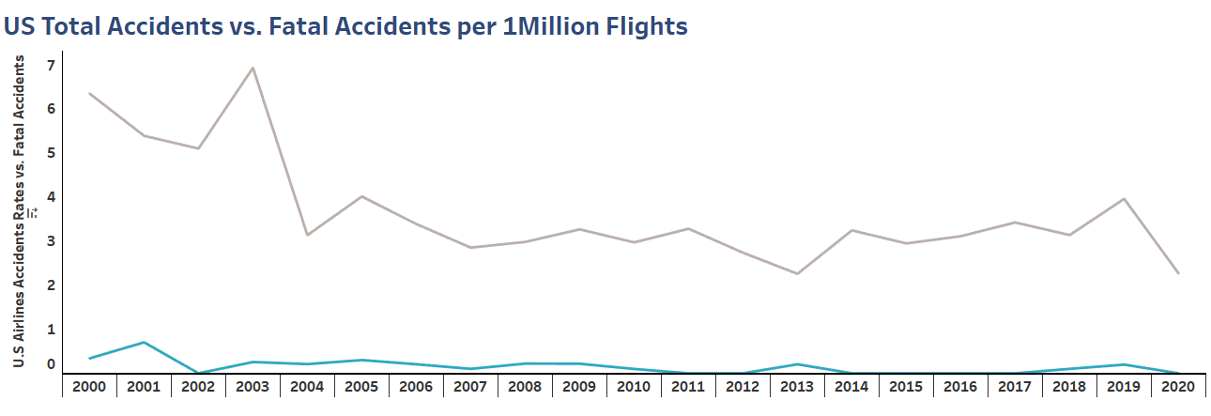
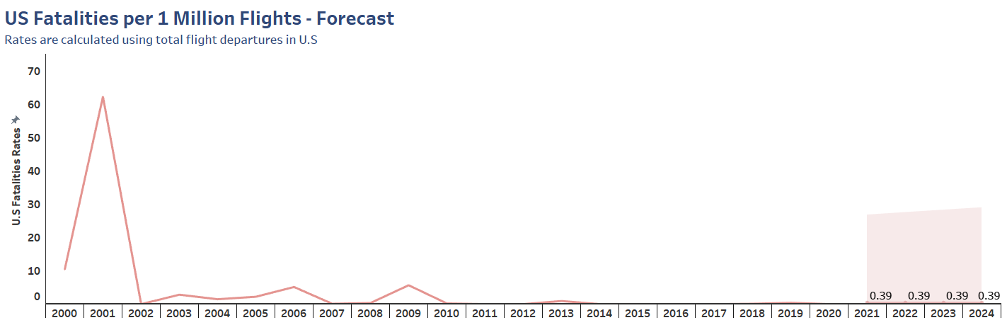
Potential risks in terms safety
Though Fatal Accidents rate has declined over time, Total accidents are still steady in number that could be potentially fatal accidents in future. Additionally, there is a forecasted fatality in 2020-2024, that shows potential safety risk.

Slide 16

Recommendations
Overall, the findings show, air travel is the safest mode of transportation and has been consistently safe for past decade. Moreover, airline industry is consistently growing since 2010 and performing well financially, except for Global pandemic in 2020. These findings can be shared to public and media and make them aware about the safety in the industry by doing awareness campaign. We can convert some of this information and make it easier for public to understand in various manners. For example, some of the things that we can share to the public:
Comparison of airline safety to other modes of transportation.
Statistics on accidents and fatalities in terms of passenger carried or departures.
Statistics on accidents and fatalities in terms of miles traveled.
Information about the main plane crashes but also let them know about the current fatalities and accidents rates.

Slide 17
Sources
Airline Safety
Aviation Safety Network
Airline Data Project
Transit Safety
Motor Vehicle Safety
Commercial Airline Safety
List of U.S airline accidents
2016 airline earning new
2015 Decline in sale
2009 airline revenue drop

